Slide 1
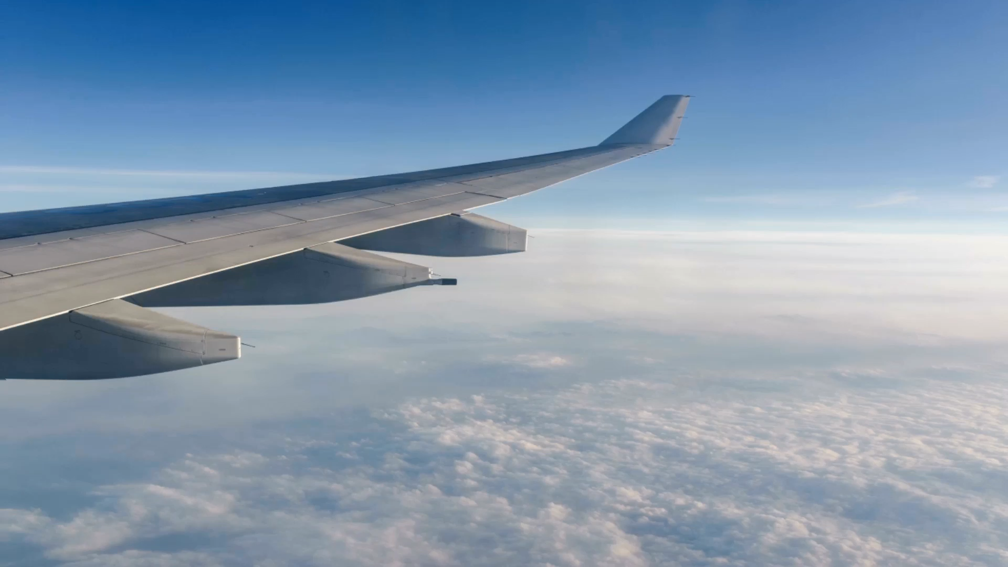

IS AIR TRAVEL SAFE?
6.3 Project Task 5: Video Presentation
Let’s see what the data says..
Amit Saxena
5/25/24
Notes:
Hello, my name is Amit Saxena. I’m a Marine Engineer working with SAP as an Architect for Intelligent Asset Management. As part of assignment 6.3 in DSC640 Data presentation and visualization, I'm going to present my research, analysis and conclusion in this short video presentation. My goal is to evaluate if air travel is safe.

Slide 2
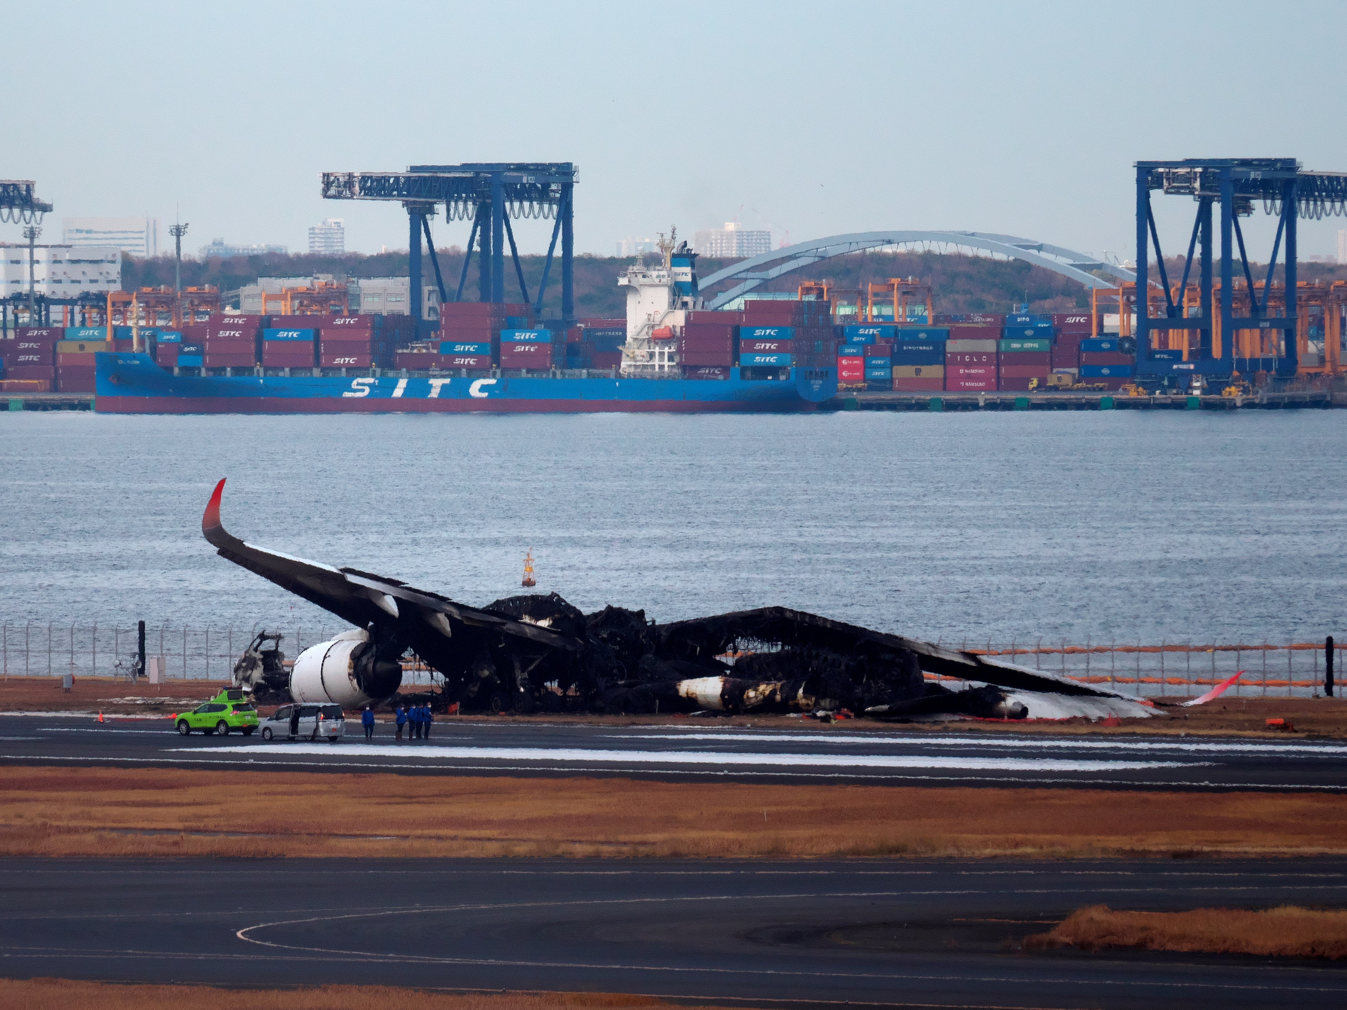
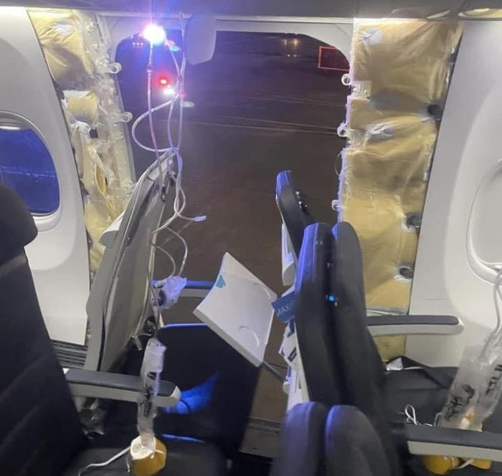
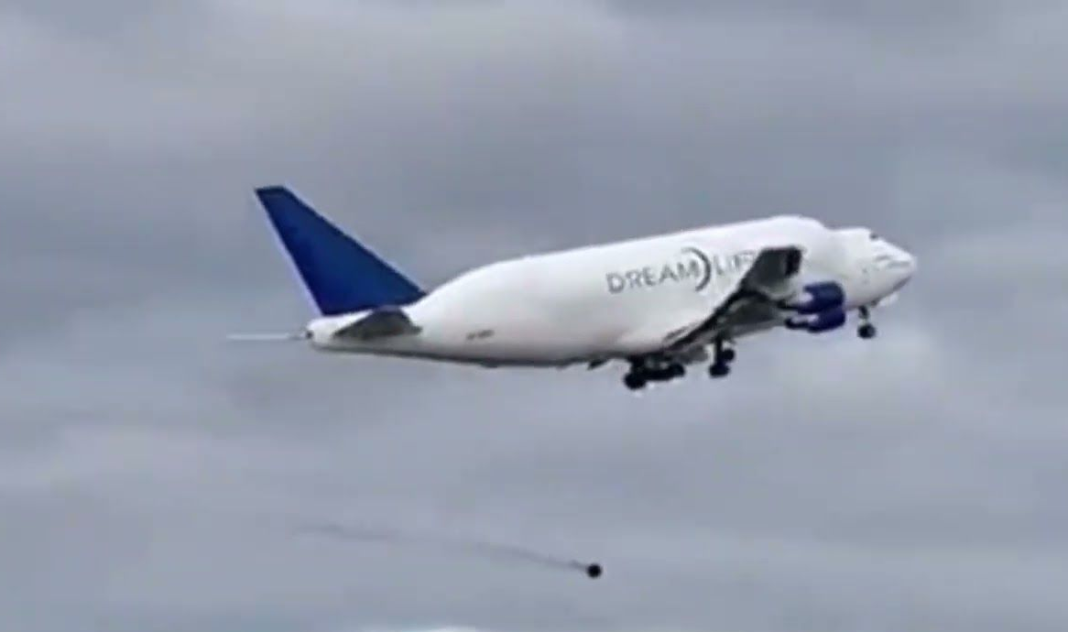
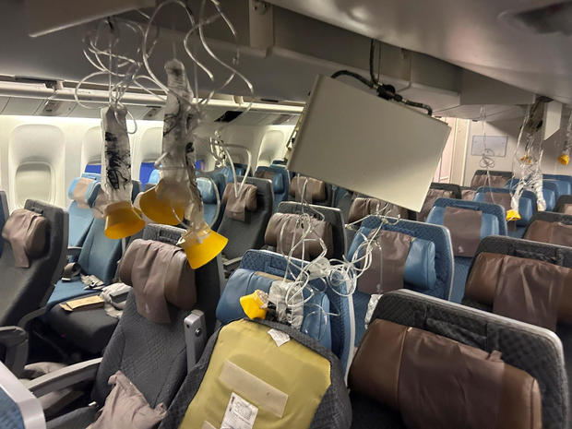
Accidents in 2024
Japan Airlines Runway Collision
Alaska Airlines Door-Plug Blowout
Aircraft Losing it’s Wheel
Singapore Airlines Severe Turbulence
Notes:
Recently, a spate of high-profile airline accidents reported in media this year have left a negative impression on the public.
There was the fiery Japan Airlines runway collision on Jan. 2, followed days later by the Alaska airlines’ door-plug blowout. An aircraft lost it’s wheels during takeoff, and Singapore Airlines flight last week, in which a man died from a suspected heart attack after the plane encountered severe turbulence.
These headline-grabbing events have left the public to wonder whether it is still safe to fly.
I have collected some data on airline safety and did research based on the data and facts to determine if flying is still safe or not. Let’s go ahead and look at some of the visualizations to check my findings.

Slide 3
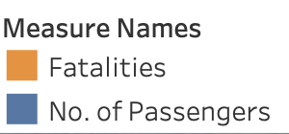
Fatalities vs No. of Passengers in Billions
Notes:
I started by comparing the no. of fatalities to the total no. of passengers who took air travel every year from 2004 till 2021.
As you can clearly see in the chart, the no. of passengers are in billions whereas the fatalities are mostly in single digits. The maximum percentage of fatalities in year 2006 was 0.000002%, which is extremely low.

Slide 4
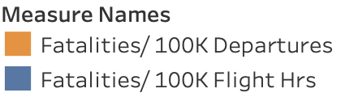
Fatalities per 100K Departures & Flight Hrs
Notes:
Next, let’s check the fatalities per 100K departures and 100K flight hours.
As you can see in this slide, the highest no.s in year 2009 are 0.5 fatalities per 100K departures and 0.3 fatalities per 100K flight hours. I didn’t display the no.s on the chart as it was getting very difficult to read them.

Slide 5
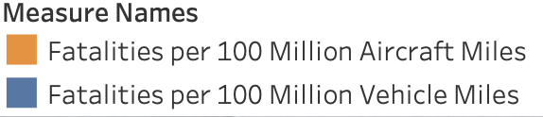
Fatalities per 100 MM Miles of Road vs Air Travel
Notes:
Now let’s compare air travel to road travel. We’ll look at the fatalities per 100 million miles of air travel Globally vs road travel in US alone.
The fatalities in road travel are consistently more than the fatalities in air travel. If we can compile the road fatality data for the whole world the differences would be even greater.

Slide 6
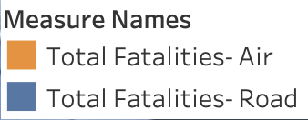
Total Fatalities- Air (Global) vs Road (US)
Notes:
When we check the total fatalities while traveling by road in US and while traveling by air Globally every year from 2002 till 2021, the comparison clearly highlights the extremely small no. of fatal accidents and deaths in air travel when compared to fatal accidents and deaths in road travel.
An average of more than 100 people died per day on US roads alone between 2003 and2022. More people died during road travel in 2 days, on average, than the total deaths during air travel in the same period of 19 years.

Slide 7
Accidents by Modes of Transport
Notes:
On checking the accidents in different modes of transport using the bar charts, the small no. of accidents in air travel compared to highway, railroad, and waterborne becomes evident.
Please keep in mind that I’ve kept the scale logarithmic so that all bars are visible in the chart.

Slide 8

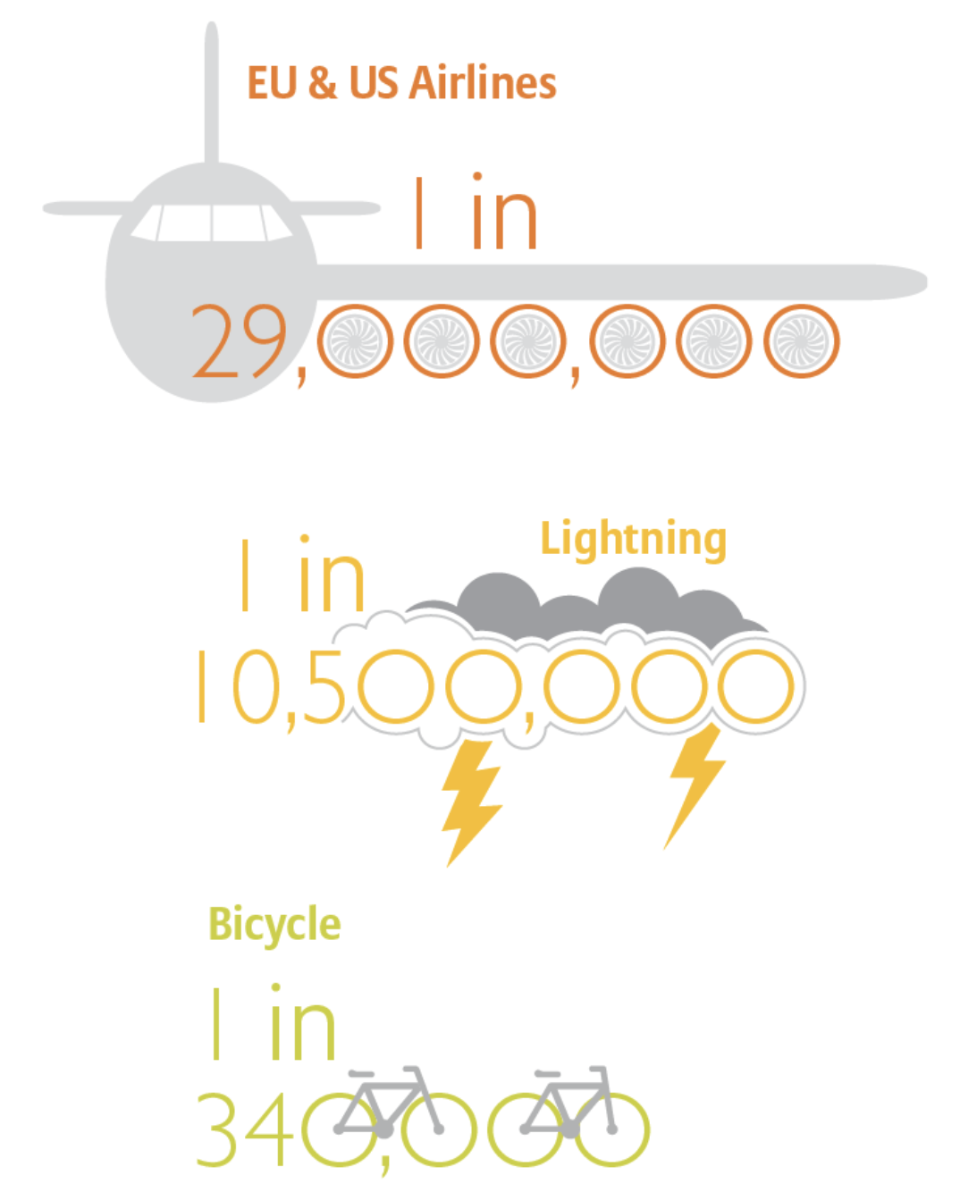
Conclusion
The data driven approach to analyze air travel safety was very insightful and I’m convinced that air travel is one of the safest modes of transport and I recommend further analysis based on facts and publishing of the findings to present the true picture to the public, that-
AIR TRAVEL IS SAFE!
Notes:
As per the data I used to research and create the visualizations in this presentation, it is very clear that air travel is a lot safer than other modes of transportations like road, rail or waterborne.
Apart from improved regulations, the improvements in engineering has also made air travel safer over the years. The engines are a lot more reliable today than they were in the past decades.
As per the FAA, commercial aviation fatalities in the US have decreased by 95% over the past 20 years.
The International Civil Aviation Organization also reports a 10% decrease in accidents in 2022 compared to 2020, and a 65% drop in fatalities.
Despite the perception of risk, the data demonstrates that boarding an airplane remains significantly safer than the drive to the airport.
Remarkably, there were no fatalities reported among the 37 million commercial airline flights in 2023.

Slide 9
Ethical Considerations
Being aware that no personal information has been used in the analysis without permission.
The study should not create a negative perception of any countries’ flight safety record.
The data used in the study should be anonymous.
Reference all the sources of the data and information used in the study.
References
Link- Accidents Spur Concern But Air Travel Remains Safe | TIME
Link- https://commercial.allianz.com/news-and-insights/expert-risk-articles/how-aviation-safety-has-improved.html
Pic1- By Makochan12.9 - Own work, CC BY-SA 4.0, https://commons.wikimedia.org/w/index.php?curid=143460716
Pic 2- 416111899_660898979455910_8686159749104350273_n-700x933.jpg (700×933) (thejetset.com)
Pic 3- maxresdefault-2.jpg.optimal.jpg (1280×720) (pcdn.co)
Pic 4- Severe turbulence on Singapore Airlines flight 321 from London leaves 1 dead, others injured, airline says - CBS News
U.S. Air Carrier Safety Data- Airline Safety, GitHub
Transportation Accidents by Mode- Fatality Analysis Reporting System (FARS), NHTSA
No. of Passengers in Millions (2004-2021)- Statistics, Bureau of Aircraft Accident Archives; ASN Aviation Safety Database, Aviation Safety Network
Notes:
Here are some ethical considerations I kept in mind while working on the data and the links to the data I’ve used in the creation of graphs and charts and the sources of news items that I have used in the narration.
Thank you very much for your time and I hope I was able to prove that air travel is a very safe mode of transport despite the negative media reports.

